Slide 1

Sauce & Spoon
Tablet Rollout
Impact Report

Slide 2
Executive Summary
The Tablet project was implemented with the expectation that rolling out tablets to for ordering and check payment would improve customer wait time and the overall customer experience as well as increase revenue through both added sales and cost reduction. The goal was to increase customer satisfaction to 98%. At the time of the table rollout initiation survey’s showed a satisfaction rating of 72% which has since increased to 86% while also improving table turn times by 30 minutes and increasing monthly revenue by 20%. The changes observed also managed to increase customers served by 10% daily which directly correlates to the additional revenue.
These accomplishments were achieved through the processes of installing the tablets, teaching staff to use and train customers on the tablets and the improvements it allowed us to make in operational processes in our back of house. Additionally the tablets enable us to continue gathering data directly from our customers in order to ensure we identify and stay in front of any challenges that could be compromising the experience and service our customers receive during each visit.
Through this process we have identified that there is still room for improvement in the within the kitchens that can be ironed out as we deploy tablets to other locations which will help further improve order accuracy and ultimately the satisfaction of our customer base.

Slide 3
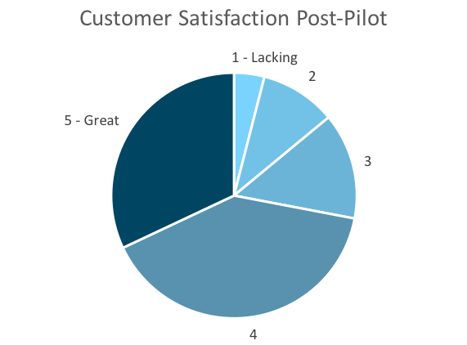
Customer Satisfaction: Pilot
Q. On a scale of 1-5, please rate your experience with the tablet overall.
This pie chart illustrates the results from the post-pilot survey.
72% of respondents indicated a customer satisfaction score of 4 or 5.
Notes:
First pie chart: Results from the post-pilot survey
Second pie chart: Results from the post-launch survey, after making changes
Satisfaction has gone up from 72% (4 and 5 rating) to 86% (4 and 5 rating)
Post-pilot data:
1 - Lacking 2 4%
2 5 10%
3 7 14%
4 20 40%
5 - Great 16 32%
Post-launch data:
1 - Lacking 1 2%
2 2 4%
3 4 8%
4 22 44%
5 - Great 21 42%

Slide 4
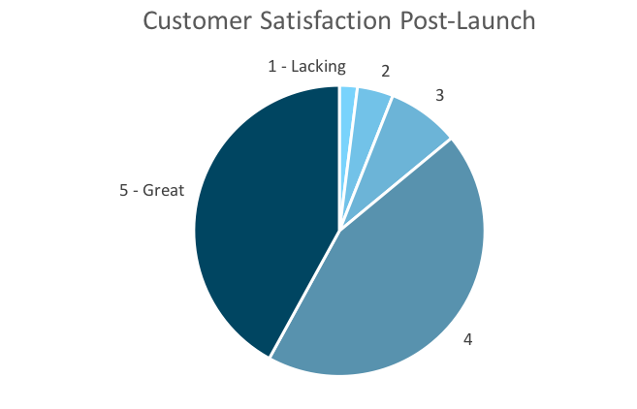
Customer Satisfaction: Launch
Q. On a scale of 1-5, please rate your experience with the tablet overall.
This pie chart illustrates the results from the post-launch survey.
86% of respondents indicated a customer satisfaction score of 4 or 5. This is a 19% increase.
Notes:
First pie chart: Results from the post-pilot survey
Second pie chart: Results from the post-launch survey, after making changes
Satisfaction has gone up from 72% (4 and 5 rating) to 86% (4 and 5 rating)
Post-pilot data:
1 - Lacking 2 4%
2 5 10%
3 7 14%
4 20 40%
5 - Great 16 32%
Post-launch data:
1 - Lacking 1 2%
2 2 4%
3 4 8%
4 22 44%
5 - Great 21 42%

Slide 5
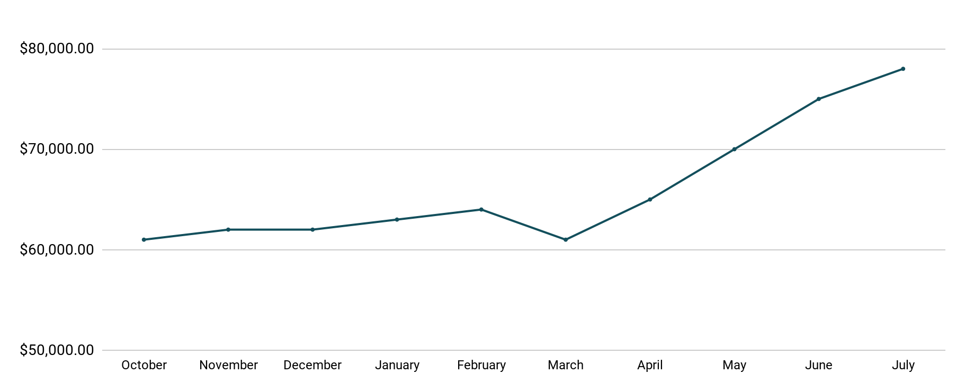
Revenue
Tablet Launch April 23
This is a chart of Sauce & Spoon revenue, showing that after tablet implementation, revenue increased.
July revenue was up to 20% over April’s monthly revenue.
Notes:
This is a chart of Sauce & Spoon revenue, showing that after tablet implementation, revenue increased. December revenue was up to 20% over September’s monthly revenue.
Sales data:
October
$61,000.00
November
$62,000.00
December
$62,000.00
January
$63,000.00
February
$64,000.00
March
$61,000.00
April
$65,000.00
May
$70,000.00
June
$75,000.00
July
$78,000.00

Slide 6
What Worked: Key Accomplishments
Decreased table turn time
Implementation of the tablets increased the average daily guest count by 10%.
Tablets also decreased wait time by 30 minutes.
Decreased food waste
Tablets identified who was receiving an incorrect order.
Kitchen staff has taken the initiative to correct orders and decrease food waste by 50%.
Increased customer satisfaction
After the pilot, customer satisfaction was at 72%.
Once we implemented improvements based on feedback, customer satisfaction increased to 86%.
Increased sales
Our monthly revenue has increased steadily since the tablet rollout, upwards of 20% since September/pre-rollout.
Tablets also helped boost revenue during the holiday season.

Slide 7
Next Steps: Looking Forward
Initiative | Action | Date
Implement tablets in more locations | Create new project plan for new location installation | Q2
Continue to track customer experience and satisfaction | Continue surveying/ gathering data through various means | Ongoing
Expand tablet features | Investigate new features like social media integration, reservations, videos, etc. | Q4

Slide 8
Appendix
Access all resources here.
Notes:
Insert link to your shared drive or a shared folder with all of the relevant project artifacts

